Slide 1
Solar Radiation Forecasting & Performance Analysis, Predict Solar Power Generation Using Machine Learning Models
Presented By
Sanjoy Kumar
Reg : 2015338532
Anwarul Mostafa Chowdhury
Reg : 2015338512

Slide 2
Overview :
Introduction
Objectives
Literature Review
Model Architecture & System Workflow
Solar Radiation Forecasting & Prediction
Identify Sub-optimal performing Equipment
Prediction of Solar Power Generation
Results & Discussion
Conclusion
References

Slide 3
Introduction

Slide 4
Introduction :
Forecasting the output power of solar systems is required for the good operation of the power grid or for the optimal management of the energy fluxes occurring into the solar system. Before forecasting the solar systems output, it is essential to focus the prediction on the solar irradiance.
The global solar radiation forecasting can be performed by several methods; the two big categories are the cloud imagery combined with physical models, and the machine learning models.
In this context, the objective of this paper is to give an overview of forecasting methods of solar irradiation using machine learning approaches. Although, a lot of papers describes methodologies like neural networks or support vector regression, it will be shown that other methods (regression tree, random forest, gradient boosting and many others) begin to be used in this context of prediction.

Slide 5
Introduction :
The performance ranking of such methods is complicated due to the diversity of the data set, time step, forecasting horizon, set up and performance indicators. Overall, the error of prediction is quite equivalent. To improve the prediction performance some authors proposed the use of hybrid models or to use an ensemble forecast approach.
Numerically solar insolation can be calculated as follows:
I(Solar irradiation) = S * cosZ − (i)
Here, S is the solar constant and it’s roughly equal to 1000 W/m^2 .
Z(Zenith angle) = cos (sinX * sinY + cosX * cosY * cosH) − (ii)

Slide 6
Objectives

Slide 7
Objectives :
Main goal of this project research is to benchmark different forecasting techniques to predict the solar Radiation output by using relevant statistical and machine learning techniques and algorithms .
Apply Feature Engineering & Exploratory Data Analysis for Identify sub-optimally performing equipment.
Machine learning techniques are benchmarked from the existing data systems installations which showed Solar power generation output on required methodologies to increase the overall prediction accuracy.

Slide 8
Literature Review

Slide 9
Literature Review :
Several methods have been employed for the existence data analysis like Support Vector Machine (SVM) and K-Nearest Neighbor (KNN) method.
The data accuracy has also been verified using Energy Pattern Factor Method, Solar Radiation Optimization Paper Method and Standard Deviation Method.
Inman et al. present an considerable survey of theory for RES forecasting. Theories from different fields are presented, such as on how to model irradiance, air masses, and clearness indices

Slide 10
Model Architecture & System WorkFlow

Slide 11
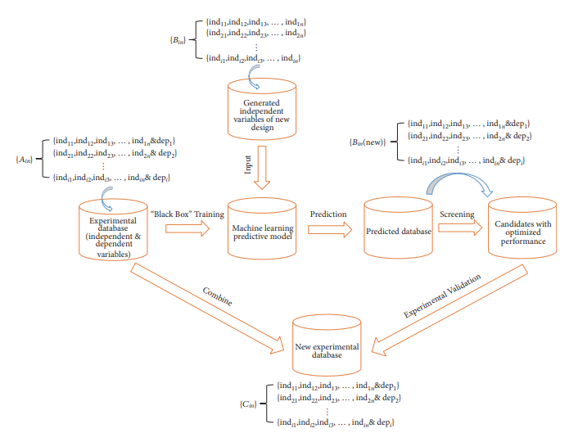
Model Architecture :
Data Collection
Data Inject
Data Cleaning & Preprocessing
Machine Learning Model Apply
Result Data

Slide 12
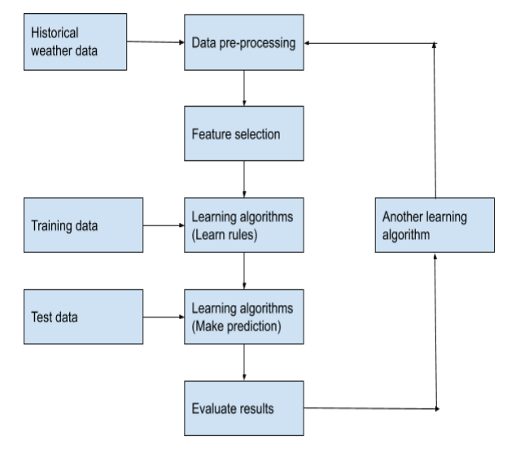
System Work Flow :
This framework consists of
Developing a predictive model and
(ii) Screening possible candidates. A combined computational and experimental case study on WGET-SWH shows that this framework can help efficiently design

Slide 13
Solar Radiation Forecasting & Prediction
1.Explotrary Data Analysis –EDA
2. Radiation ML Model Building

Slide 14
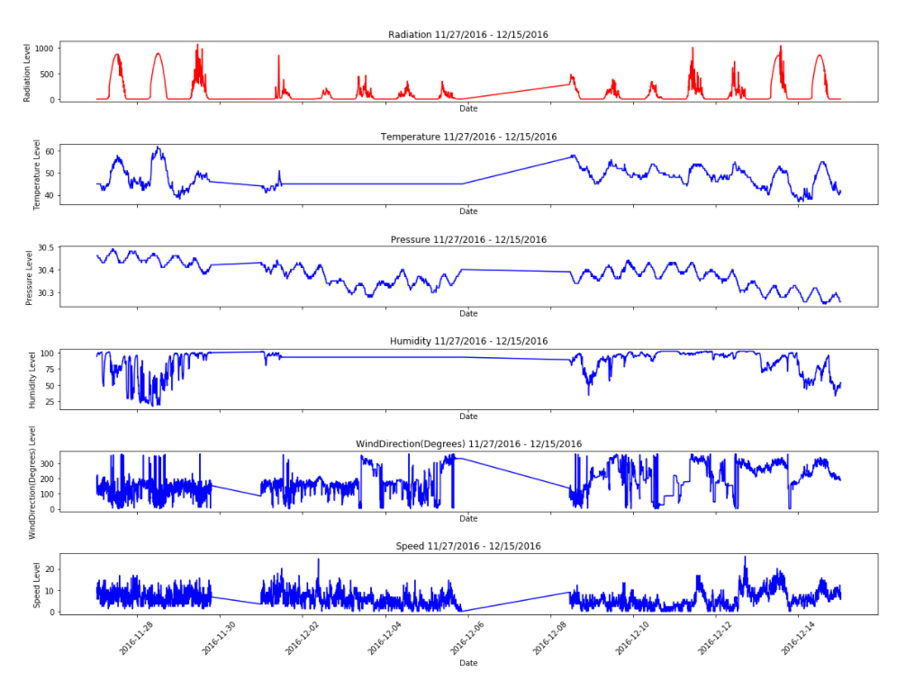
Exploratory Data Analysis :
From the graphs, the following can be seen:
Temperature and Radiation have a very close connection. Oscillations appear to be quite in step.
The volatility of wind direction could have something to do with the spikes in radiation .
Pressure is also cyclic but has a different period than radiation.
Speed and Humidity appear to be noisy but there could be something lurking there!

Slide 15
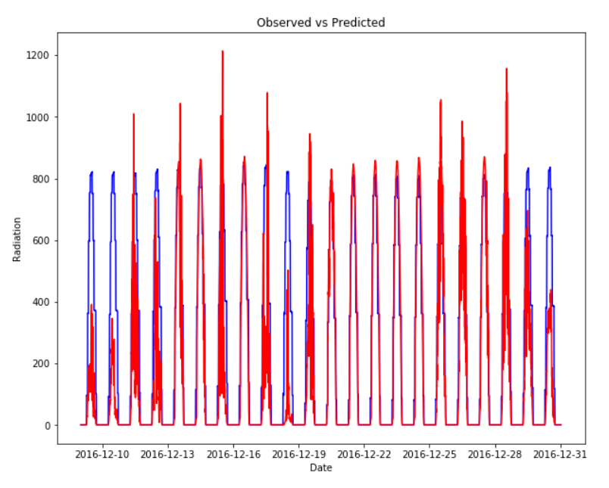
Linear Regression Algorithm :
So this is as far as a linear regression will go. This gives us a baseline R2 of 61.2% to build from with a more complicated model.
The most obvious thing that will need to be improved is the fact that negative radiation is impossible. Therefore, we will need a model that can deal with this.
Accuracy : 66.51%

Slide 16
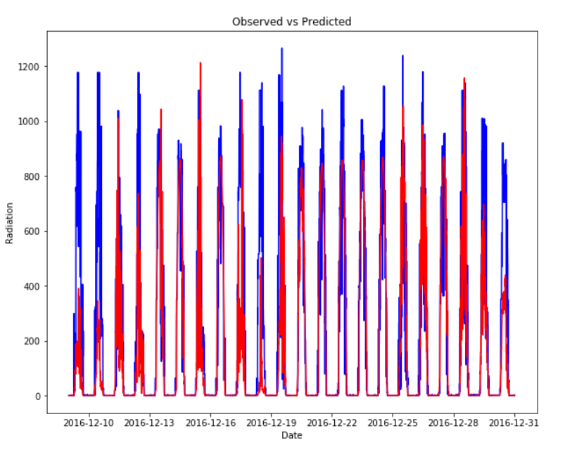
Descision Tree Algorithm :
There seems to be a large amount of noise in this model, perhaps due to overfitting.
Accuracy : 71.66%

Slide 17
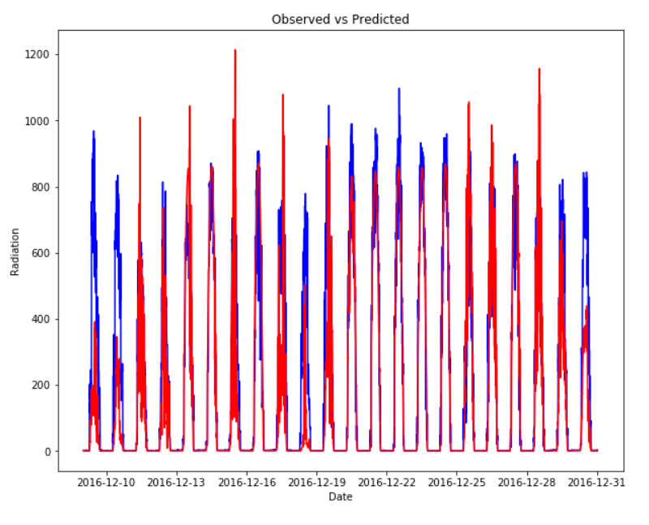
Random Forest Algorithm :
The random forest model has the advantage over the linear regression model as it does not return any negative predictions of radiation. Let us tune the model to see if the performance can be boosted.
Accuracy : 76.32%

Slide 18
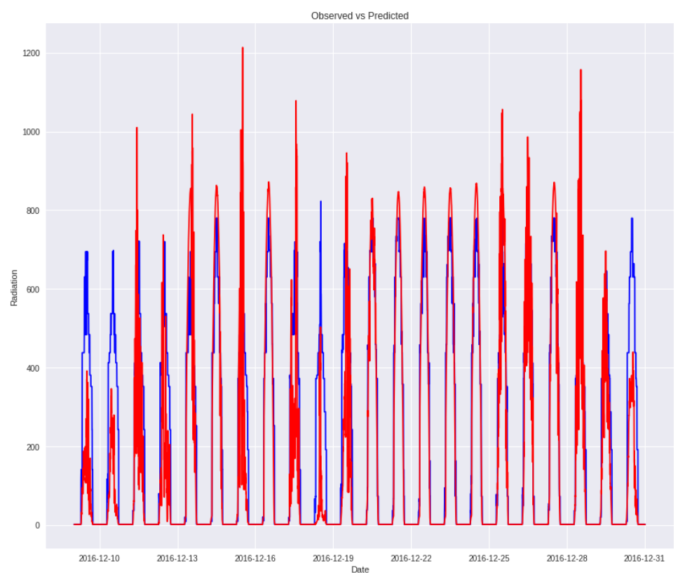
Boosted Decision Tree :
Still, it looks like model is effective at gauging oscillation of the radiation, but not the extent of the peak. This is probably due to the fact that hour from sunrise is the most important predictor, leaving little variance due to the other independent variables.
Accuracy : 86.68%

Slide 19
Identify Sub-optimal performing Equipment
Analysis Correlation of Attributes
Principle Component Analysis

Slide 20
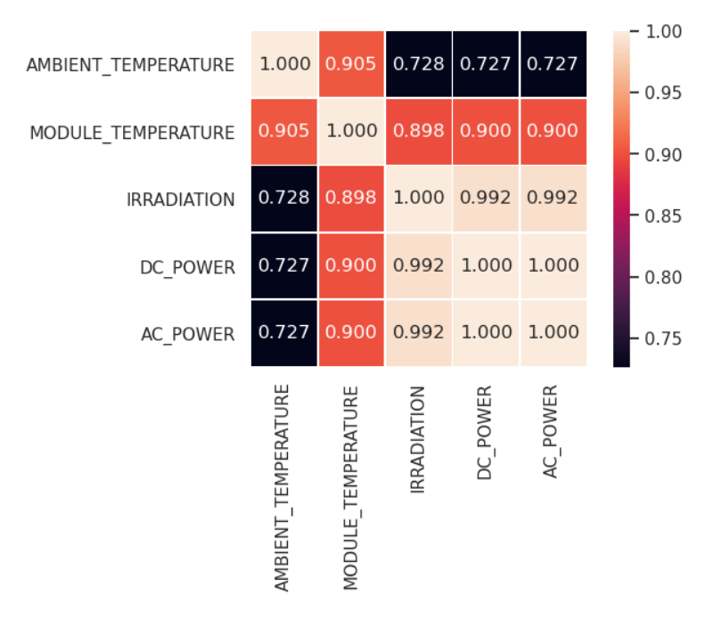
Correlation Before PCA :
DAILY_YIELD is not correlated with all feature but AMBIENT_TEMPERATURE is more less correlated.
TOTAL_YIELD is also not correlated with all feature. I remove it in the correlation matrix.

Slide 21
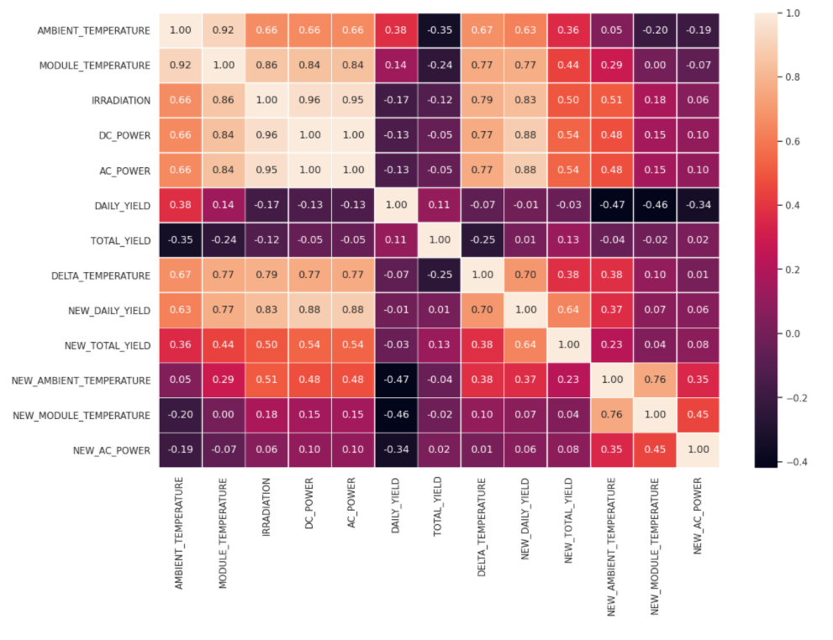
Attributes Correlation Analysis :
Throughout this notebook, we can say that
plant I produces 6 times more DC power than plant II. And loses 90% of it when converting to AC power.
While Plant II loses nothing when converting DC power to AC power.
AC power output is almost the same for both plants.
The daily yield is almost the same for the two plants.
The gap between The average total yield for plant I and plant II is very large.
Daily yield decrease if delta temperature is less than 5°C.
Daily yield decrease for some value of AC power.

Slide 22
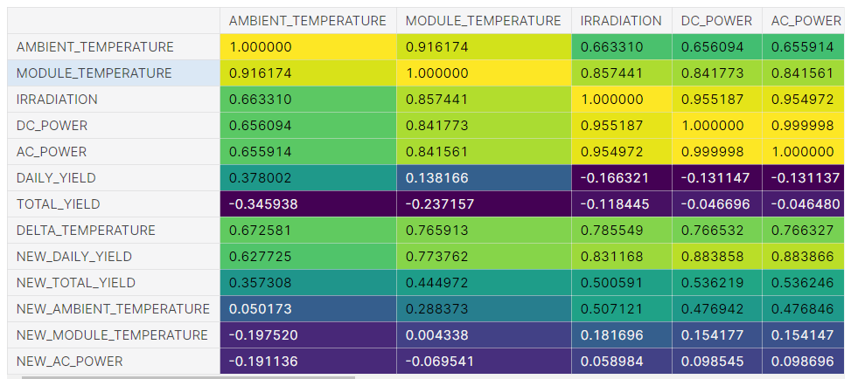
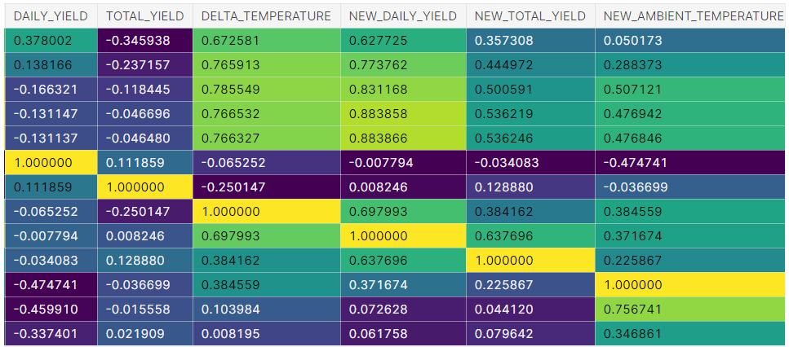
Principle Component Analysis Result :

Slide 23
Prediction of Solar Power Generation

Slide 24
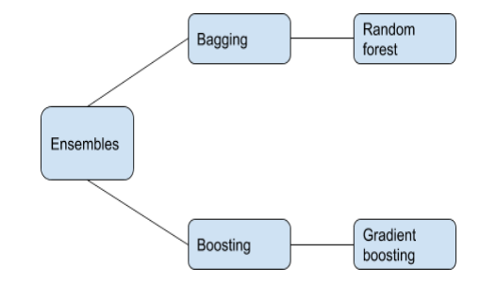
XGBoost Algorithm Technique :
We also use another ensemble technique known as random forest. It is an ensemble
bagging technique in which we make many independent variables/models/learners and
combine them using model averaging methods. In this method we divide the dataset into
6
small bootstrapped datasets so that each model/learner we are going to build gets different
data to work on. This method reduces variance for reducing error.

Slide 25
Decision Tree Algorithm Technique:
The basic idea is very simple. A response or class Y from inputs X1, X2,…., Xp is required to be predicted. This is done by growing a binary tree. At each node in the tree, a test to one of the inputs, say Xi is applied. Depending on the outcome of the test, either the left or the right sub-branch of the tree is selected. Eventually a leaf node is reached, where a prediction is made. This prediction aggregates or averages all the training data points which reach that leaf. A model is obtained by using each of the independent variables.

Slide 26
Result & Discussion

Slide 27
Result & Discussion
Model evaluation after feature selection we observed that the results improved further
Both in accuracy and MAE values.
Mean Absolute Error: 0.04%
Mean Squared Error: 0.65%
R-squared scores: 0.61
Random forest model score: 0.9425107240800619

Slide 28
Model Analysis : Decision Tree VS XGBost
Train Accuracy : 86.64 %
Test Accuracy : 82.23%
DecisionTreeRegressor
criterion='mse’,
max_depth=None,
max_features=None,
max_leaf_nodes=None, min_impurity_decrease=0.0, min_impurity_split=None, min_samples_leaf=1,
min_samples_split=2, min_weight_fraction_leaf=0.0,
presort=False
XGBRegressor
base_score=0.5,
colsample_bylevel=1,
colsample_bynode=1,
colsample_bytree=1,
gamma=0, gpu_id=-1,
learning_rate=0.300000012, max_depth=6,
min_child_weight=1, missing=nan, n_estimators=100,
num_parallel_tree=1,
Train Accuracy : 89.76%
Test Accuracy : 86.74 %

Slide 29
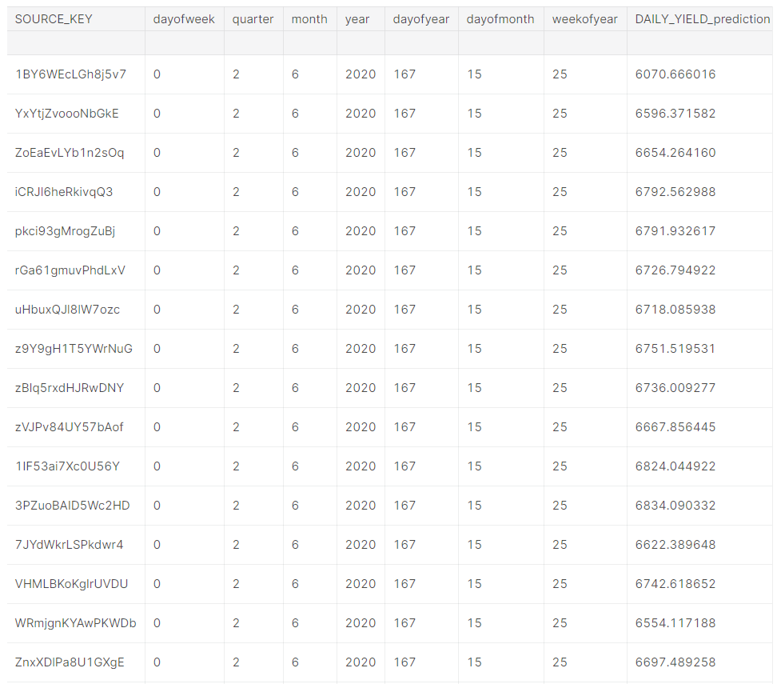
Result Data

Slide 30
Conclusion :
This work proposed a benchmarking of machine learning techniques for intraday solar forecasting. Popular nonlinear techniques such as Gaussian Processes evaluated against simple methods.
The main conclusion that can be drawn from this survey is that the machine learning techniques start to outperform their simple counterparts for forecasting.
The future operational availability in these islands of exogenous inputs (such as those provided by NWP models or Satellite data) will obviously improve the accuracy of the solar forecasts.

Slide 31
References :
[1] S. Sperati, S. Alessandrini, P. Pinson, G. Kariniotakis, The “Weather Intelligence for Renewable 886 Energies” Benchmarking Exercise on Short-Term Forecasting of Wind and Solar Power 887 Generation, Energies. 8 (2015) 9594–9619. doi:10.3390/en8099594. 888
[2] S. Pelland, G. Galanis, G. Kallos, Solar and photovoltaic forecasting through post-processing of 889 the Global Environmental Multiscale numerical weather prediction model, Prog. Photovolt. Res. 890 Appl. 21 (2013) 284–296. doi:10.1002/pip.1180. 891
[3] J.R. Trapero, N. Kourentzes, A. Martin, Short-term solar irradiation forecasting based on 892 Dynamic Harmonic Regression, Energy. 84 (2015) 289–295. doi:10.1016/j.energy.2015.02.100. 893
[4] P. Bacher, H. Madsen, H.A. Nielsen, Online short-term solar power forecasting, Sol. Energy. 83 894 (2009) 1772–1783. doi:10.1016/j.solener.2009.05.016. 895
[5] M. David, F. Ramahatana, P.J. Trombe, P. Lauret, Probabilistic forecasting of the solar irradiance 896 with recursive ARMA and GARCH models, Sol. Energy. 133 (2016) 55–72. 897 doi:10.1016/j.solener.2016.03.064. 898
[6] C. Join, M. Fliess, C. Voyant, F. Chaxel, Solar energy production: Short-term forecasting and risk 899 management, ArXiv160206295 Cs Q-Fin. (2016). http://arxiv.org/abs/1602.06295 (accessed 900 October 4, 2016). 901
[7] A. Mellit, S.A. Kalogirou, L. Hontoria, S. Shaari, Artificial intelligence techniques for sizing 902 photovoltaic systems: A review, Renew. Sustain. Energy Rev. 13 (2009) 406–419. 903 doi:10.1016/j.rser.2008.01.006.

Slide 32
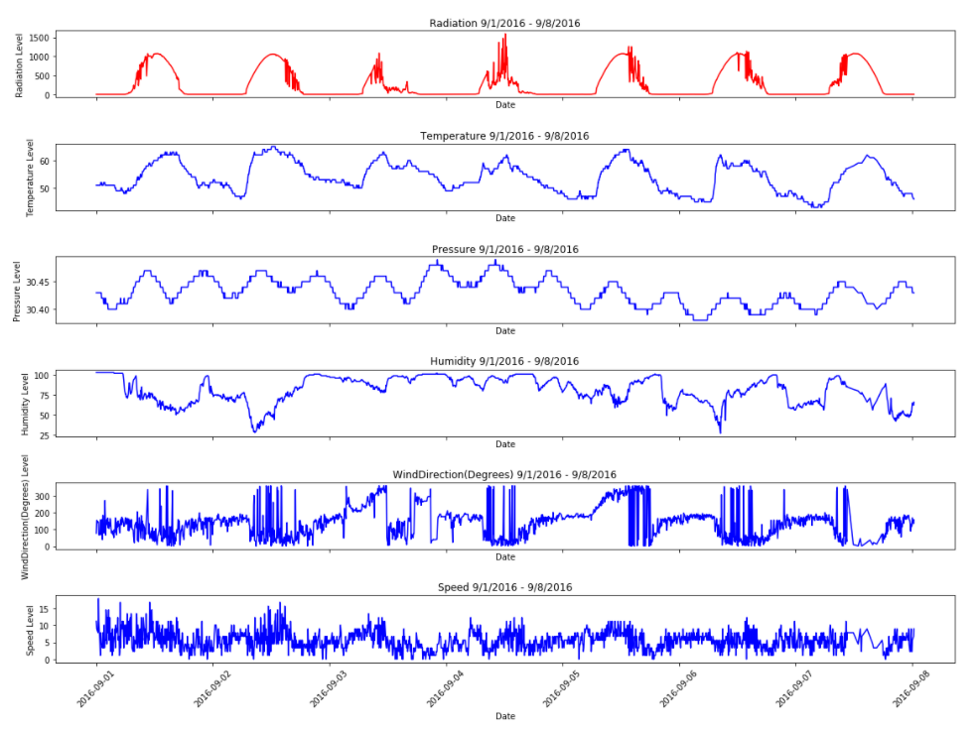
Exploratory Data Analysis : Date VS Attribute
From the above graphs, the following can be seen:
Temperature and Radiation have a very close connection. Oscillations appear to be quite in step.
The volatility of wind direction could have something to do with the spikes in radiation .
Pressure is also cyclic but has a different period than radiation.
Speed and Humidity appear to be noisy but there could be something lurking there!

Slide 33
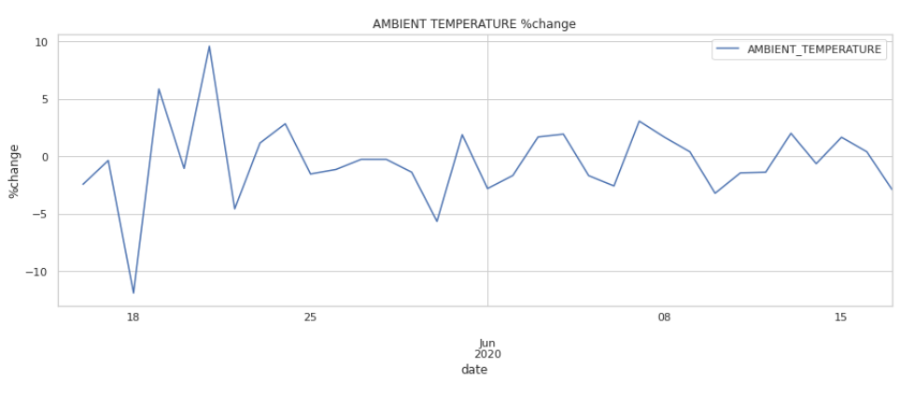
Which date ambient temperature mean is maximum?
Sunday 17 May 2020 to Monday 18 May 2020, the ambient Temperature decreases to 10%.
Monday 18 May 2020 to Tuesday 19 May 2020, the ambient Temperature increases to 15% and tomorrow decreases to 5%.
Wednesday 20 May 2020 to Thursday 21 May 2020, the ambient Temperature increases to 10% and tomorrow decreases to 15%.
June month's, the ambiant Temperature %change stabilize between -2.5 and 2.5%.

Slide 34
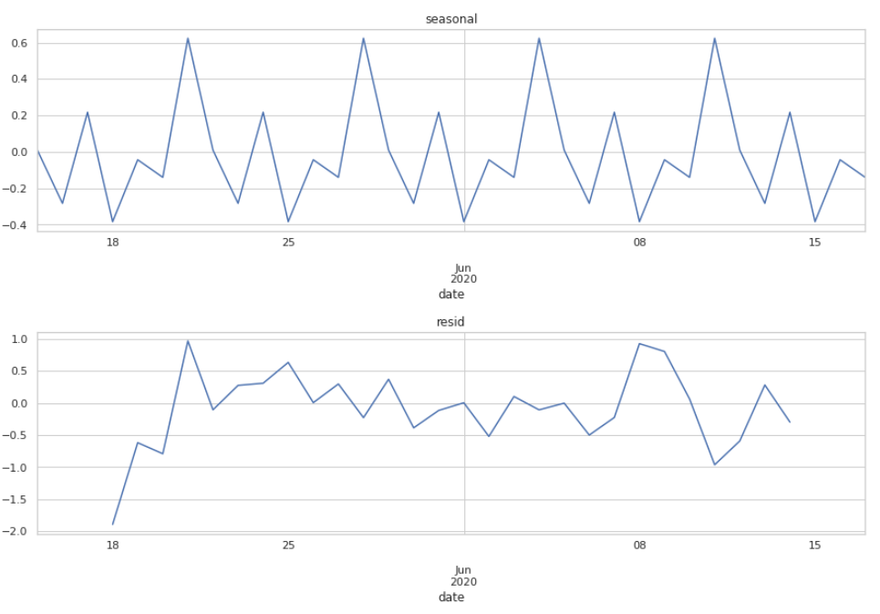
Ambient Temperature: seasonal, trend and residual.

Slide 35
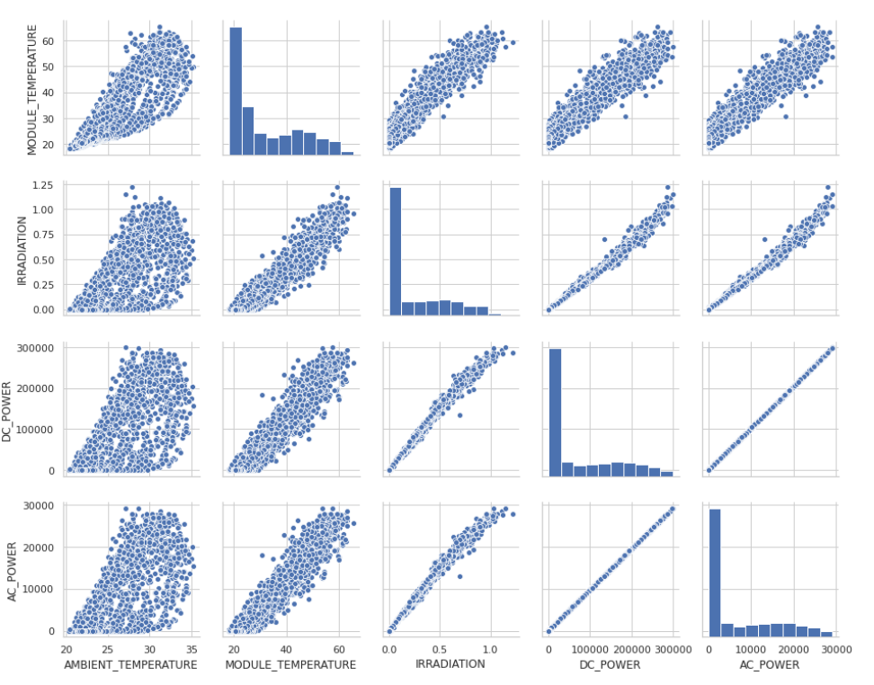
Feature Selection Technique :
The performance and effectiveness of machine learning model may be affected by useless information present in the dataset. The model results after doing feature selection becomes more accurate, easily understandable and improves model performance. Recent research have also shown that useless variables affect the performance of some algorithms for e.g. in simple nearest neighbour algorithm, the sample complexity increases exponentially with the number of useless attributes.

Slide 36
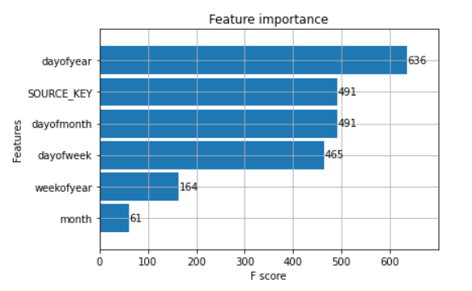
Features Important For Prediction :
We are going to measure the performance using three error metrics namely, mean absolute error (MAE), mean bias 22 error (MBE) and root mean square error (RMSE).We also did Cross-validation techniques in order to choose best parameters for number of decision trees to use in Random forest ,max depth of tree, tree split factors etc.

Slide 37
Mean Square Error (MSE)
Mean square error of an estimator is measure of squared average of the errors i.e. average
squared difference of squared values of true and measured values.It is exploring of how
close is the fitted line to the data points. MSE is always positive is due to randomness. The lower is MSE value of the model is better.
Calculation of MSE:
MSE = ∑(D1 - D2 )^2
where,
D1 − Estimated value
D2 − Measured value
N − Number of observations

Slide 38
Model Analysis : XGBOOST Regressor
XGBRegressor(base_score=0.5, booster='gbtree', colsample_bylevel=1,
colsample_bynode=1, colsample_bytree=1, gamma=0, gpu_id=-1,
importance_type='gain', interaction_constraints='',
learning_rate=0.300000012, max_delta_step=0, max_depth=6,
min_child_weight=1, missing=nan, monotone_constraints='()',
n_estimators=100, n_jobs=0, num_parallel_tree=1,
objective='reg:squarederror', random_state=0, reg_alpha=0,
reg_lambda=1, scale_pos_weight=1, subsample=1, tree_method='exact',
validate_parameters=1, verbosity=None)
Train Accuracy : 89.76%
Test Accuracy : 86.74 %

Slide 39
Analytics Term :
X is latitude and Y is solar declination.
H(Hour angle) = 15 * (time − 12) − (iii)
Time equals the hour of day from midnight.
For example, noon equals 12 and 4 p.m. equals 16.
The maximum power output from PV cell can be calculated as follows:
Pr = ηSI[1 − 0.05(to − 25)] − (iv)

